Slide 1

Building a Loadable Kernel Module (Sign & Verification) and Implementation on a Raspberry Pi.
Presented by:
Mahmoud Gahelrasoul 00775836
Yasin Elmezayen 22306157

Slide 2
Contents
Overview and Motives
Project Application Details
Implementation on Raspberry Pi
Constraints
Future Aspects
Conclusions

Slide 3

Introduction and Motives
Kernel Module Signing Uses cryptography to sign and verify modules, ensuring kernel security by preventing unsigned or invalid modules without needing external components.
Dynamic Kernel Modules (LKMs)Allow Linux kernel to expand functionality without rebooting, crucial for modular development in embedded systems.
Discussion on Implementation on Raspberry Pi: Apply cryptographic signatures to ensure module authenticity on Raspberry Pi devices during boot and operation.
Project Goals: Develop and sign a kernel module using a self-generated key for enhanced security.
Security Benefits: Prevent unauthorized code execution by verifying cryptographic signatures, ensuring system reliability in secure environments.
Future on implications and benefits of signed kernels and modules in embedded systems.

Slide 4
Project Application

Slide 5
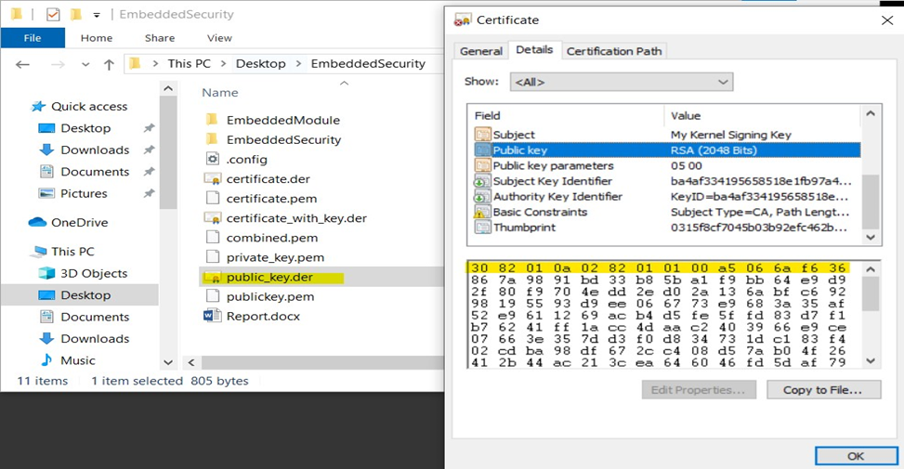
Generating Keys and Certificates:
Public and Private key Pair:
The OpenSSL tool is used
Two Key Pair is created
The private key is for signing modules
Public key is included in the certificate.
DER Extension of Public Key
The DER format is a binary form of the PEM format that can be used by various applications.

Slide 6
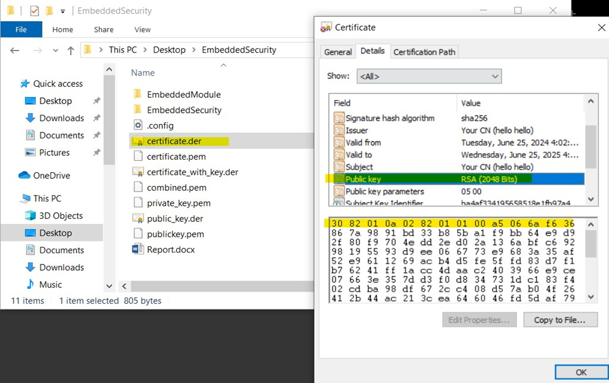
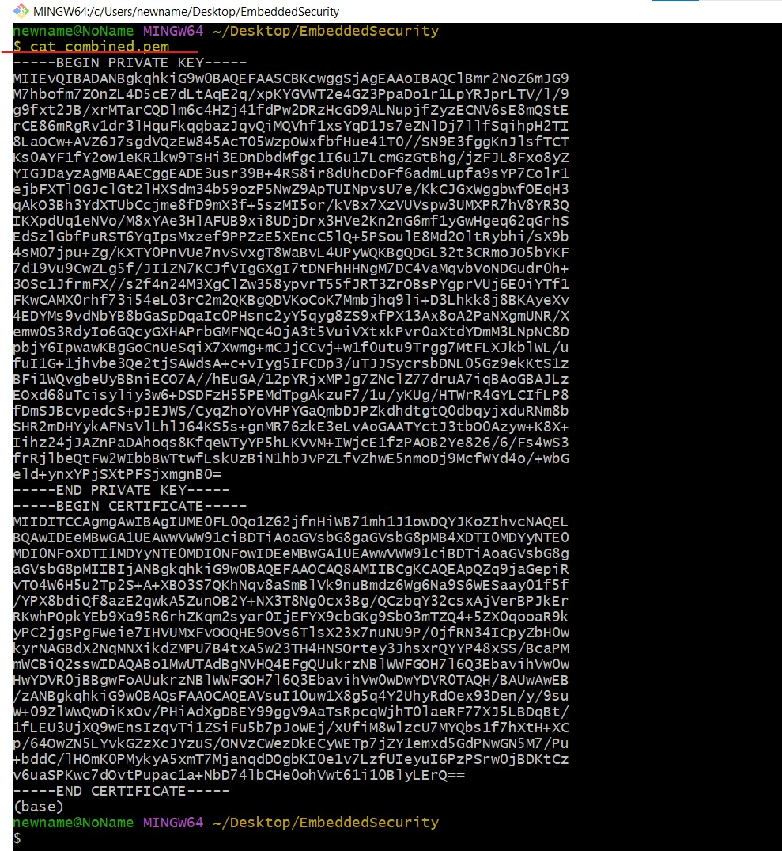
Generating Keys and Certificates:
Self-signed Certificate:
Created by using the private key.
Necessary for the kernel to trust the signature on the modules
Combined Certificate:
The private key + the self-signed certificate into a single file.
Required for the kernel configuration

Slide 7
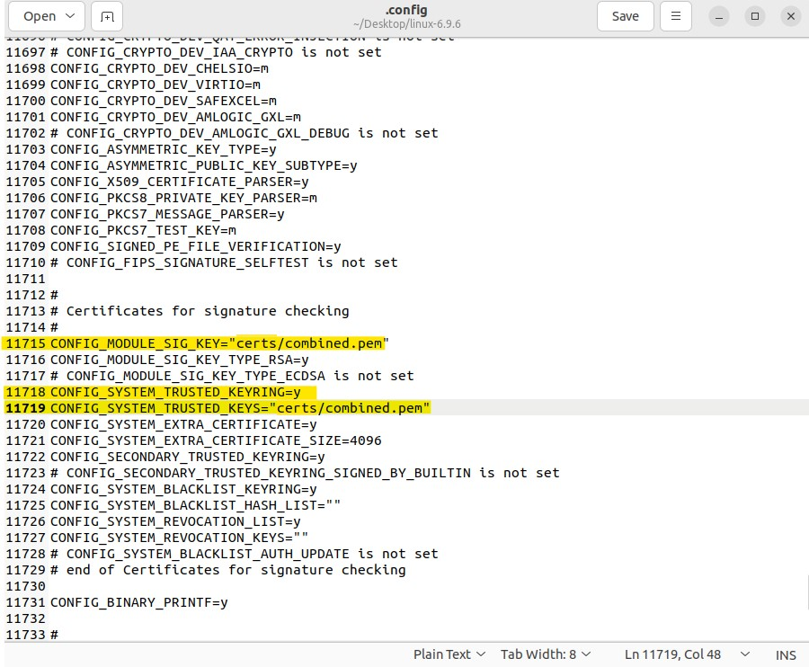
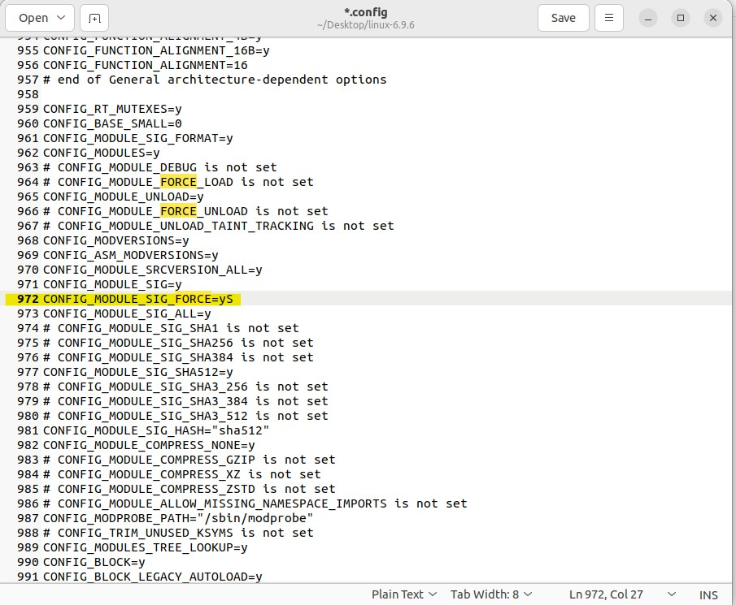
Adding Certificate to Kernel:
Transfer of Certificate:
the combined certificate is copied into the kernel source tree
Kernel Configuration:
Either with ‘make menuconfig’ or
Editing the kernel configuration ‘.config’ file directly.

Slide 8
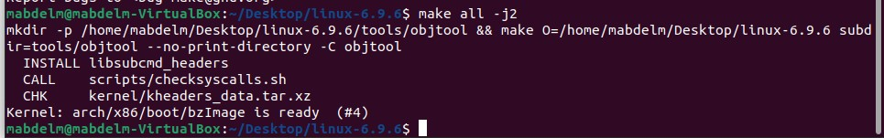
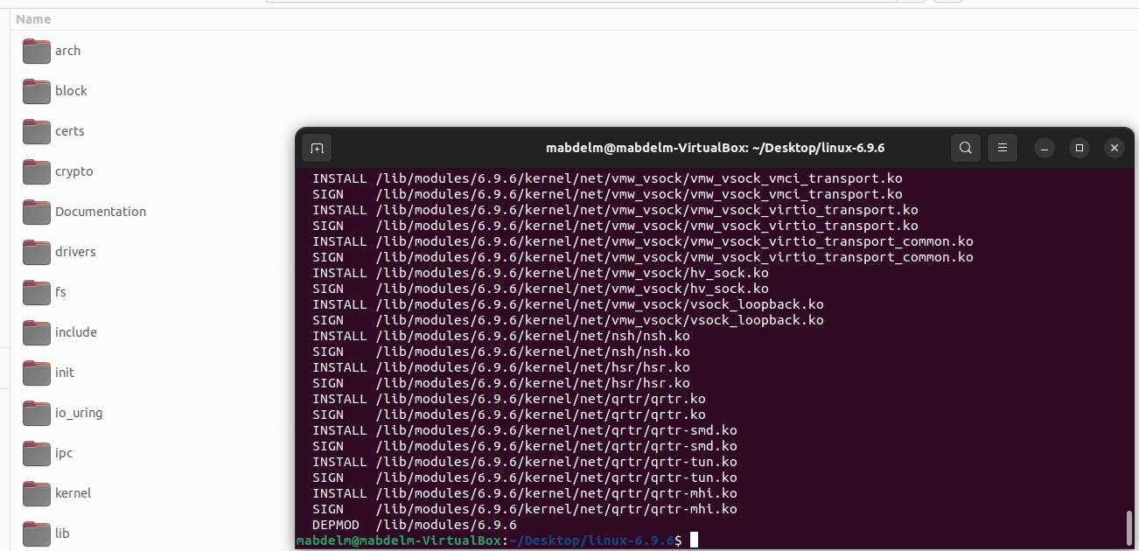
Building the Kernel:
Compiling the Kernel:
Firstly, lean the build environment to ensure a fresh build
Then, Configuration of the kernel
Installing the Kernel:
Once the kernel and modules are compiled

Slide 9

Building the Kernel:
Updating the Bootloader:
The GRUB bootloader is Updated to recognize the new kernel
Rebooting the System:
Rebooting the system to load the newly compiled kernel with the incorporated certificate
The kernel will utilize the specified certificate for module signing
Check the running kernel version

Slide 10
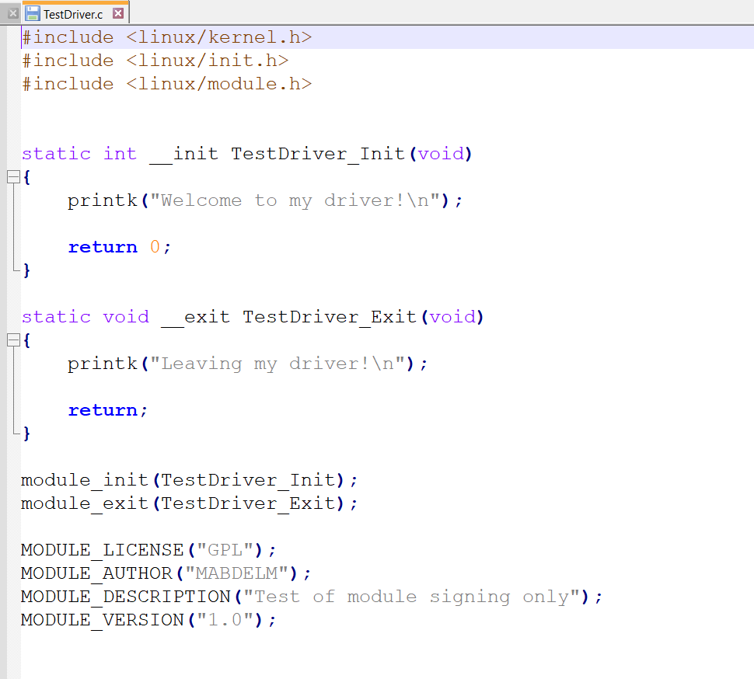
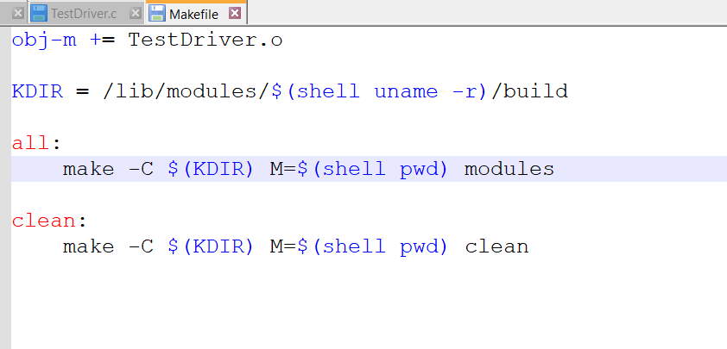
Implementing and Signing Kernel Modules:
Creating a Kernel Module:
Source Code Creation (‘TestDriver.c’) Makefile Creation: For building the module

Slide 11
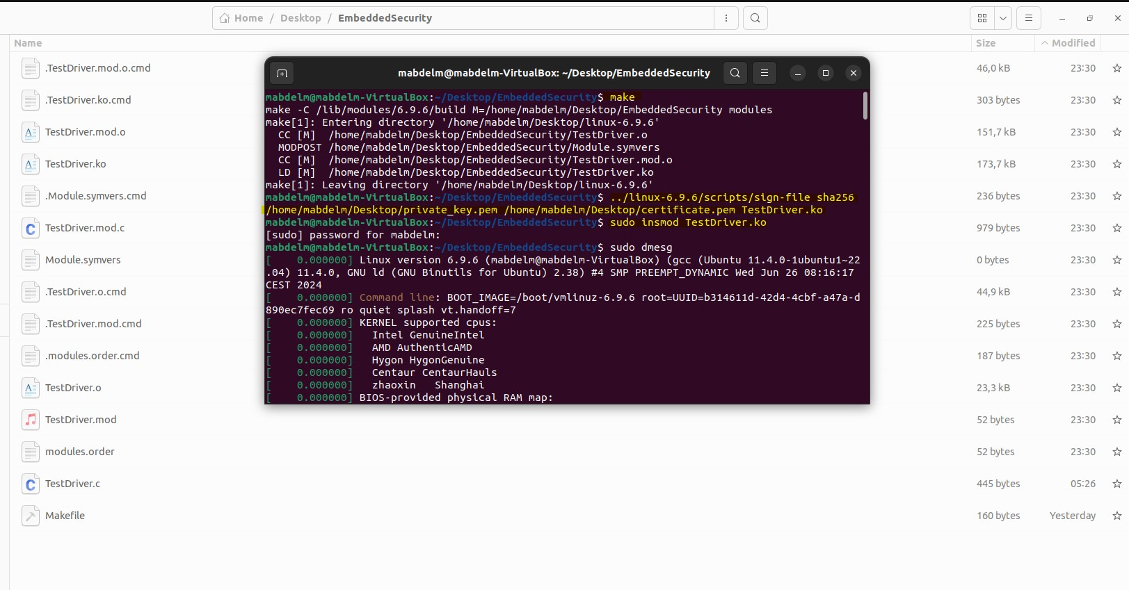
Implementing and Signing Kernel Modules:
Compiling the Kernel Module (‘make’ command):
Compiling the ‘TestDriver.c’ source file into a loadable kernel object file (‘TestDriver.ko’).
Signing the Module: Sign Commands With Paths to Private Key and Certificate

Slide 12
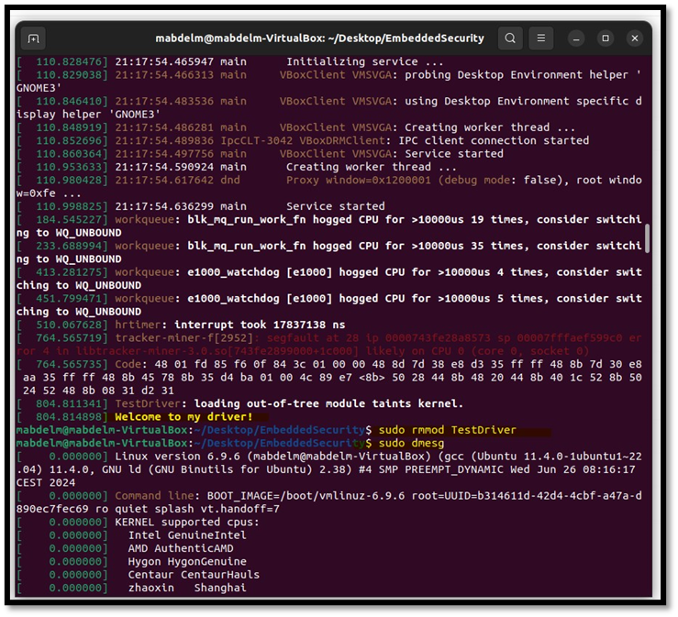
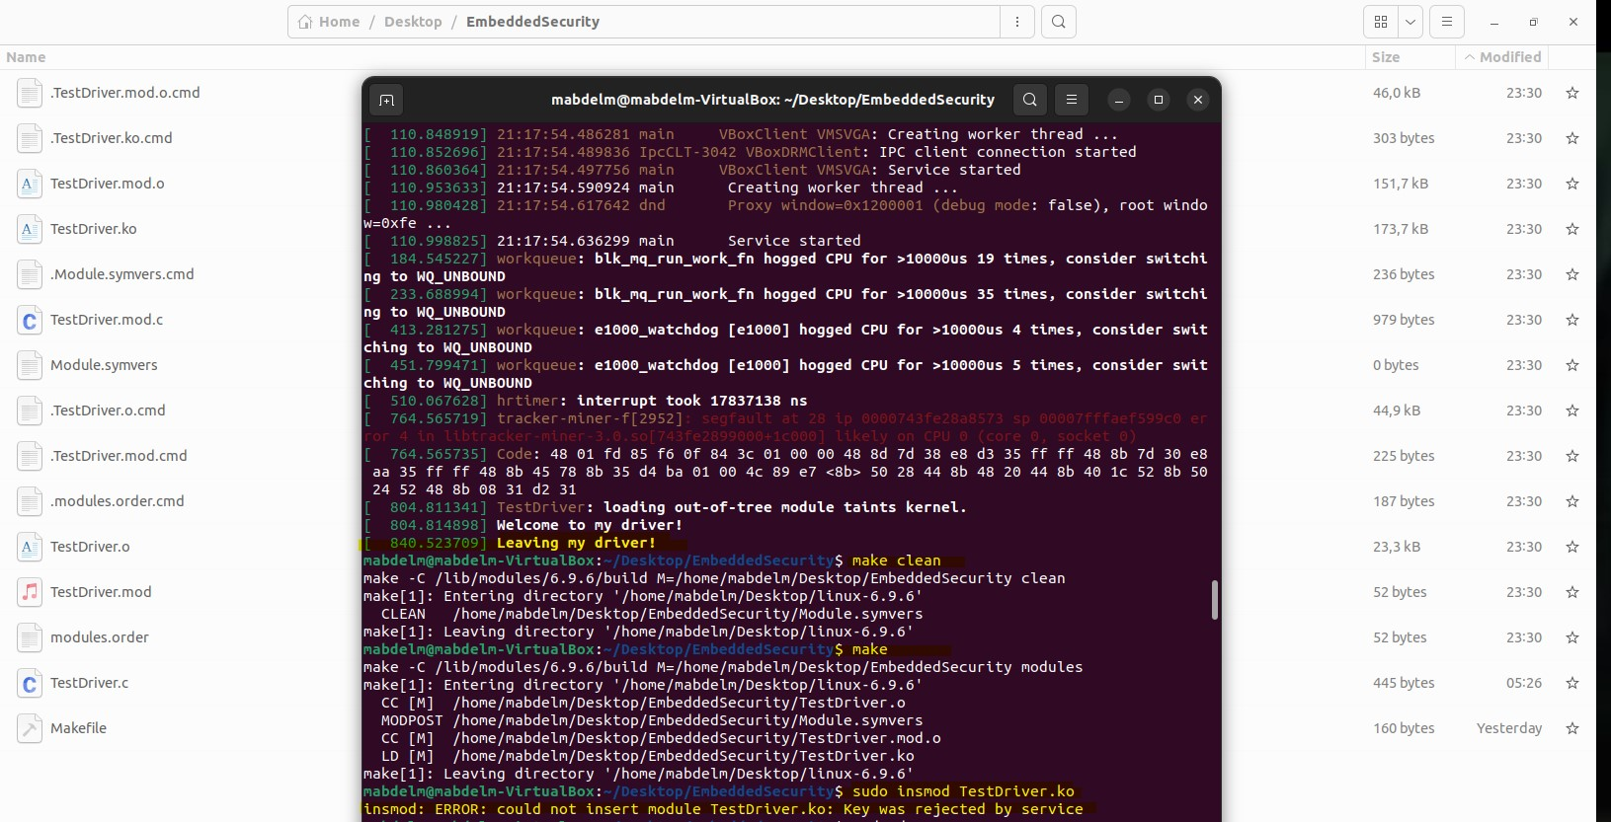
Implementing and Signing Kernel Modules:
Loading The Signed Module (sudo insmod TestDriver.ko)
Unloading the Signed Module (sudo rmmod TestDriver)
Verify successful loading and Unloadin via kernel logs (sudo dmesg)

Slide 13
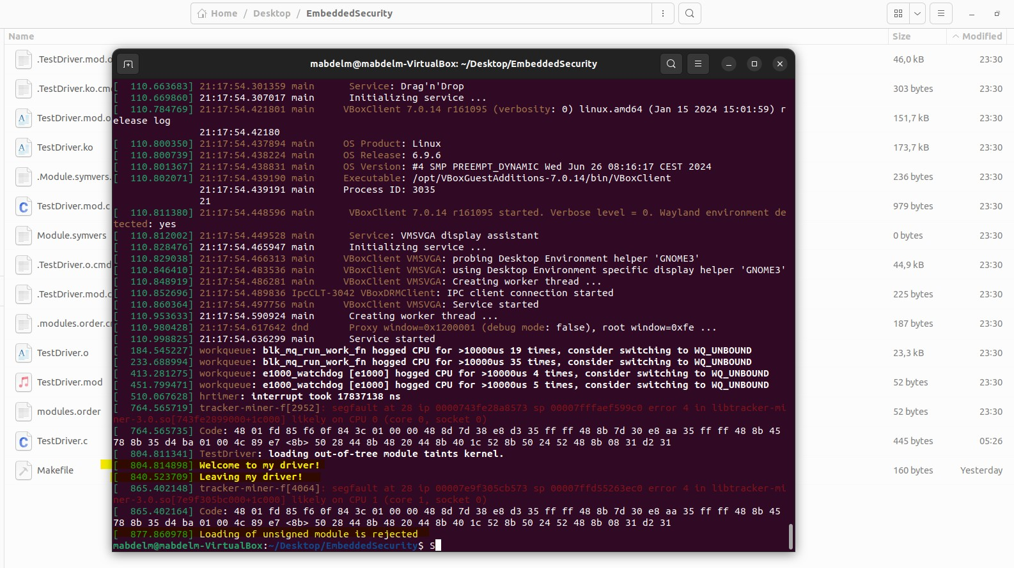
Implementing and Signing Kernel Modules:
Trying to Load an Unsigned Module:
kernel is configured to enforce signature verification and the Command fails.
The Final Log ..

Slide 14
Raspberry Pi Implementation

Slide 15

Approaches:
Native Compilation:
Compiling software directly on the target hardware platform
Used in Small-scale projects
In development environments where simplicity outweighs compilation time.
Virtual Machines or Emulation:
Use of Emulation to run the target architecture on a host machine
In Development environments where access to actual hardware is limited
In testing software

Slide 16

Approaches:
Remote Compilation Servers
Building farms to perform compilation tasks on behalf of developers
In Large-scale software projects where compilation times are critical
Cross Compilation:
Compiling code on one platform (the host) to produce executables for a different platform (the target)
Useful for embedded systems like the Raspberry Pi, which have limited processing power and memory

Slide 17
Building and Signing Kernel and a Module Using Cross-Compilation :
Native Compilation (Update)
the first part of implementing this project into a raspberry pi but with some small differences and adjustments regarding cross compilation.
Steps are:
Setting Up the Cross-Compilation Environment
Configuring the Kernel
Build the Kernel

Slide 18
Building and Signing Kernel and a Module Using Cross-Compilation :
Steps are:
Preparation Prior to transferring
Transferring Files to the Raspberry Pi (SCP/USB)
Installing the Kernel Image
installing Device Tree Blobs
Installing Kernel Modules
Updating Boot Configuration
Reboot the Raspberry Pi
Verifying the Installation
Cross-Compilation and Transition:
Installing the kernel and building the modules involves transferring the compiled kernel image, the certificate, and the private key to the Raspberry Pi.
The Raspberry Pi depends on this to utilize the newly built kernel and modules for testing or deployment

Slide 19

Compiling and signing the Kernel Module
Compile the Kernel Module
Sign the Kernel Module
Both Steps use similar commands as before
Only here they happen on the Raspberry Pi

Slide 20
Loading and Unloading Checks for the Signed Module
Loading the Module
Unloading the Module
Loading Try for an unsigned module
Similar commands as before also applied here

Slide 21
Hurdles:
Initial kernel build failed due to inadequate machine capabilities; upgraded to a more powerful computer.
Second attempt took three hours but lacked proper configuration.
Third attempt succeeded after an eight-hour build, with configuration adjustments made during the build process.
Implementation on a Raspberry Pi emulator failed due to complex kernel and bootloader setup, cryptographic operation challenges, and inherent security limitations.
Challenges include the complexity of building and signing kernels and modules, requiring deep knowledge of kernel development and cryptography.
Signature verification adds computational overhead, potentially reducing system performance.

Slide 22
Future Aspects:
Further research needed for implementing the project on a physical Raspberry Pi, focusing on detailed steps and micro-steps.
Investigate and expand projects on emulation environments to explore broader application scenarios.
Test on more powerful hardware for private compilation or improved cross-compilation performance.
Explore alternative compilation methods and their applications.
Enhance cryptography levels and implement additional authentication and verification methods.

Slide 23
Conclusions
Built a signed kernel and loaded modules using a private key and certificate
Kernel ensured integrity and authenticity of modules through cryptographic verification.
Prevented loading of unsigned or incorrectly signed modules.
Applied these methods to a Raspberry Pi board, including cross-compilation, secure file transfer, and bootloader configuration for secure boot.
Cryptographic signatures enhanced system security by allowing only verified modules to load.
Implementation on Raspberry Pi showed feasibility and effectiveness in maintaining system integrity and reliability in an embedded system environment.

Slide 24


Thank you!
Any Questions?

